Slide 1

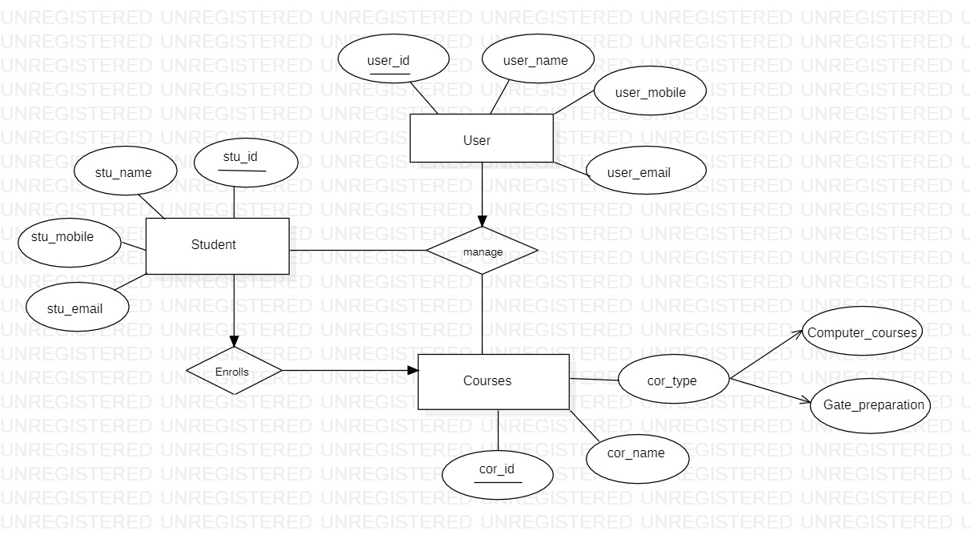
Online Course Management System
DISADVANTAGES
Hardware requirement(min.) -> 512MB of RAM P-IV processor or higher
Software requirements (min) -> Virtual studio 2010, sql server 8.0,flask
Operating system -> windows 11
ADVANTAGES
The main objective of Online Course Management System(OCMS) is to enhance the learning process
Mature
Safe and Secure
Ease of Use
Flexibility
Convenience
E-learning approaches
Self-paced learning
Connectivity
Equipment
Software
Training
This web application will provide students all the resourses they want regarding any computer course e.g. C language, HTML,CSS , web development, DBMS, JAVA etc.

